Slide 1
User experience work at ITA
Åsa Lindström
KTH ITA, Usability designer (April 2013 - )
Unikum, Interaction designer (web application for primary school) (2011-2013)
Ericsson, SW developer, UX designer, Business solution owner Intranet
(1999- 2011)
Student at KTH (Engineering Physics, Master’s thesis MDI 1998)
Art schools (1985-1991)
Notes:
Hi Åsa Lindström
working at KTH IT department as a Usability designer
Been here since April last year
Thanks to Olle, for invited me
here to talk abot User experience work at ITA
Before KTH:
I worked a shorter period in a smaller company
As an intetaction designer for a web application targeting primary school.
I started at Ericsson 1999
first worked as a SW developer a
2005 I started work with usability.
I have worked with e.g.
UX processes,
Personas,
requirement handling,
interaction design,
usability test,
For webapplications, mobile and Ericsson intranet.
I did my Master’s thesis at KTH MDI 1998
And before that I have study several years at Art schools

Slide 2
Agenda
How are ITA working with user experience today?
Discuss
What can MID gain from a cooperation with ITA?
How can ITA use your knowledge best?
Notes:
To day I will first show
How we at ITA are working with user experience today?
The last ten minutes I hope we can start a Discussion about
What you at MID
can gain from a cooperation with ITA?
And how we at ITA can
use your knowledge best?

Slide 3
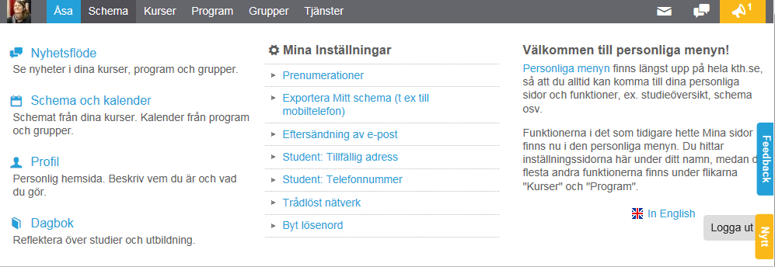
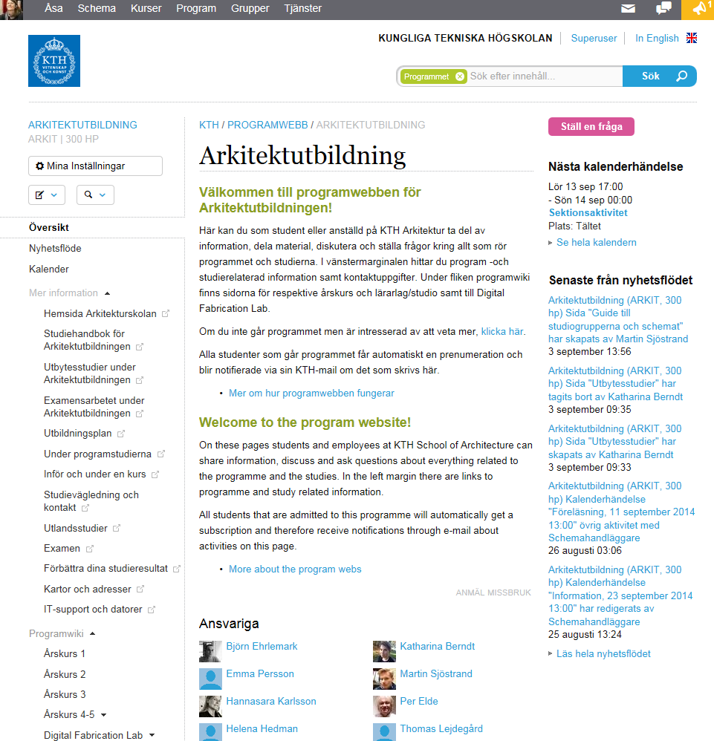
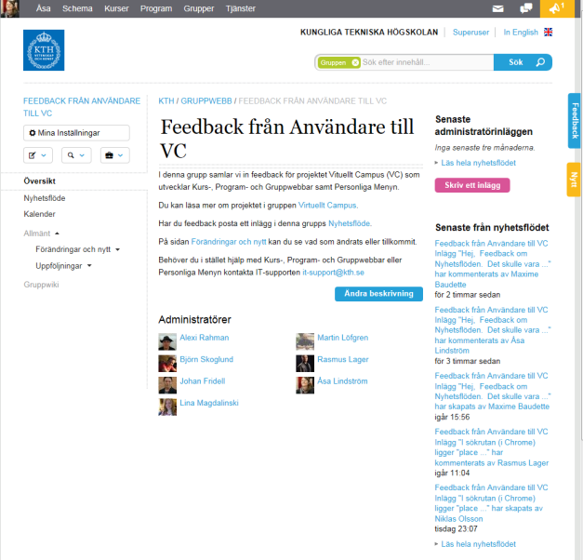
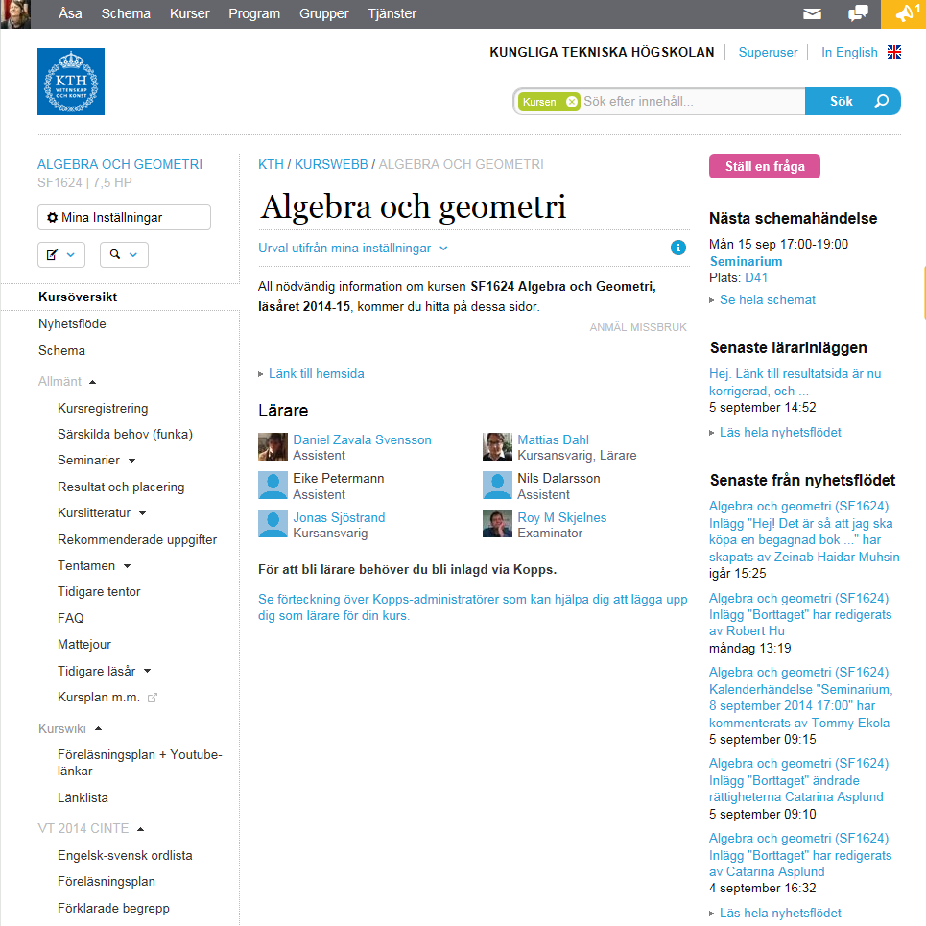
Virtuellt Campus
Develops
  Course-, Program and Group web
  Personal menu
  Profile
Started 2009
Part of ITA part used most UX resources
Notes:
I work at the part of ITA that develops Virtuellt Campus.
Develops
Course-, Program and Group web
Personal menu
Profile
Started 2009
Part of ITA part used most UX resources
Are you using some of these?
You probably have some feedback,
We can go through this afterwards or y
you can use this blue feedback button

Slide 4
What are we doing?
In the UX area
Notes:
I will
briefly go through what
I have been working with
since I started 1,5 years ago
I have divideed my time between
interaction design,
usability test and
some user study work

Slide 5
Interaction design
New design and integrating new functions
Course-, Program and Group web, feel like an integrated part of kth.se
  Change menu to adapt to kth.se
  Start a work to get a cleaner layout
Integrate requested functions (input from teacher survey) in the course web e.g:
  Assignments
  Course survey
Notes:
Inteaction design in Virtuellt Campus have been
for some bigger areas and
A lot of small improvement
One of the bigger design changes for the Course-, Program- and Group web was
Change menu to adapt to kth.se,
Goal: feel like an integrated part of kth.se
This was also a start for a work with a cleaner layout
Another bigger interaction design and developing efforts have the integration
Of two requested functions (input from teacher survey) in the course web as
Assignments
Course survey

Slide 6
Interaction design
Small improvements
  Listen to feedback from users, follow usability guidelines and make small improvements.
  Students have identified two important areas:
  schedule,
  notifications
  We have also done an underlying continuos work to:
Collect and structure
Explain
Limitations with small improvements
Notes:
We spend a lot of our time with smaller improvements
Listen to feedback from users, follow usability guidelines and make small improvements.
From students have identified two important areas:
schedule,
notifications
We have also done an underlying continuos work to:
Collect and structure
Explain
Limitations:
Problems with small isolated improvements.
Need to see improvements in a bigger context to get a consistent user experience

Slide 7
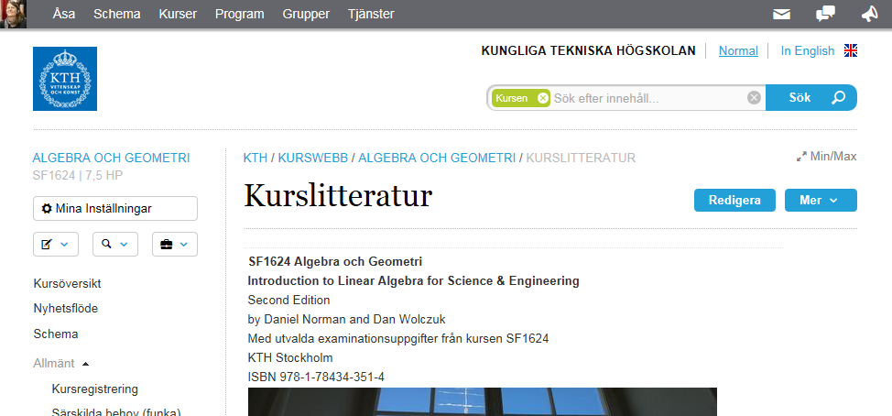
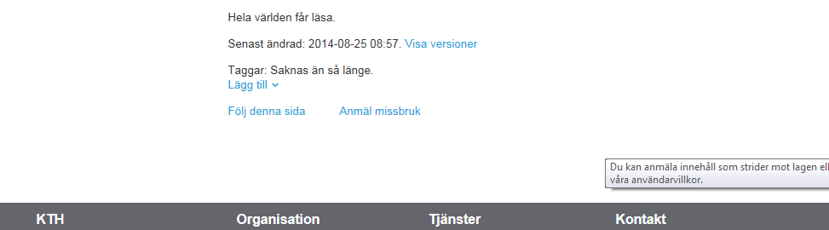
Examples
Left menu, page design
Content in focus - Collect and structure
Notes:
I will show some examples of the changes in the course web
Here you can see a course web and the left menu, the top and bottom of a page. ’
Our goal was to
Collect, structure so that
user content are in focus
tasks/ actions appears in similar places
To get
a cleaner and more consistent layout
, easier to see how things relate when you place them together
Example here is the left menu and pages,
You can se the tools, actions collected …

Slide 8
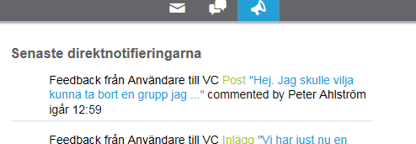
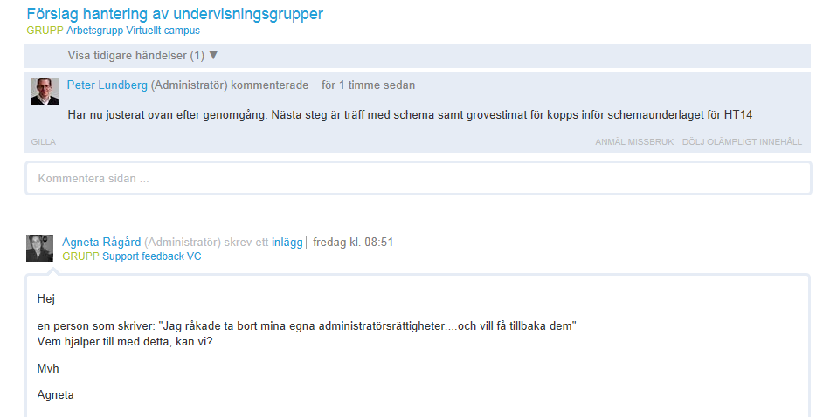
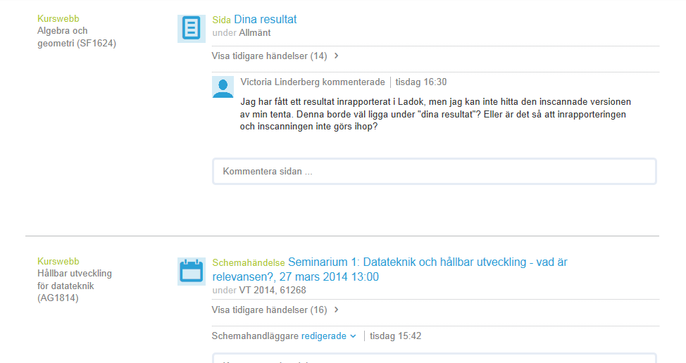
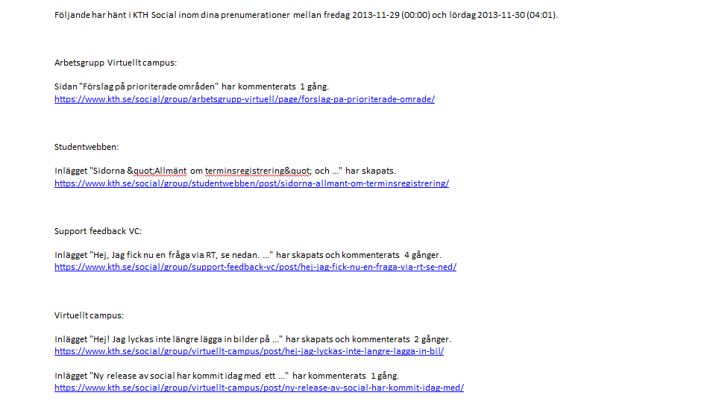
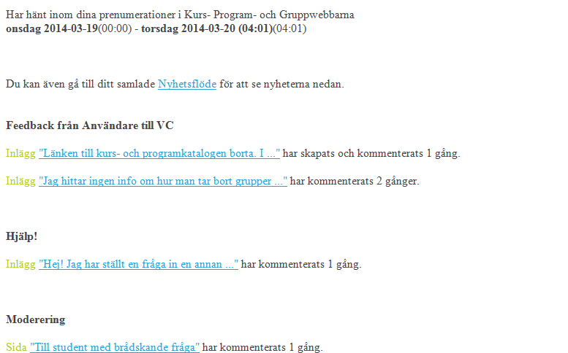
Examples
News feed and notifications
Hard to reed, feels like spam Also worked with a consistent layout
Notes:
Some examples from the News feed and notifikcations
User input: Hard to reed, feels like spam
We also worked with a consistent layout
For mail, news feed and now direct notifications

Slide 9
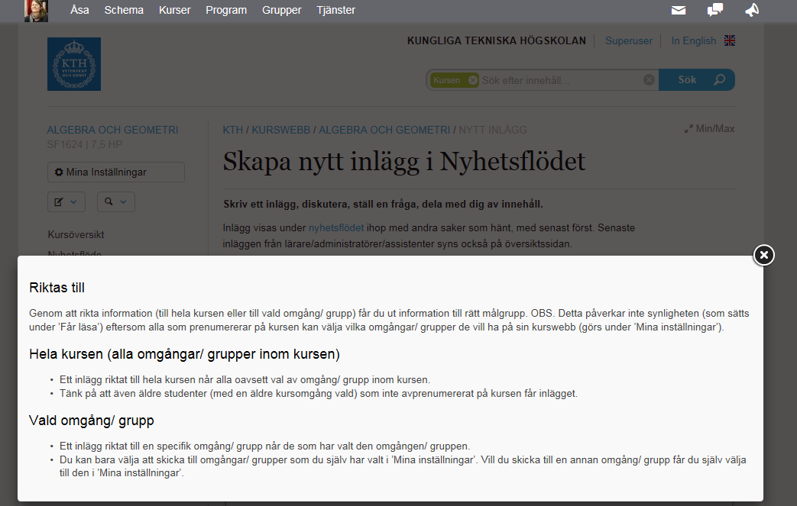
Examples
Explain
Notes:
We have also done an continuos work to:
Explain
Parts not intuitive
Information is added under e.g. i-icons
Example here is from making a new post.

Slide 10
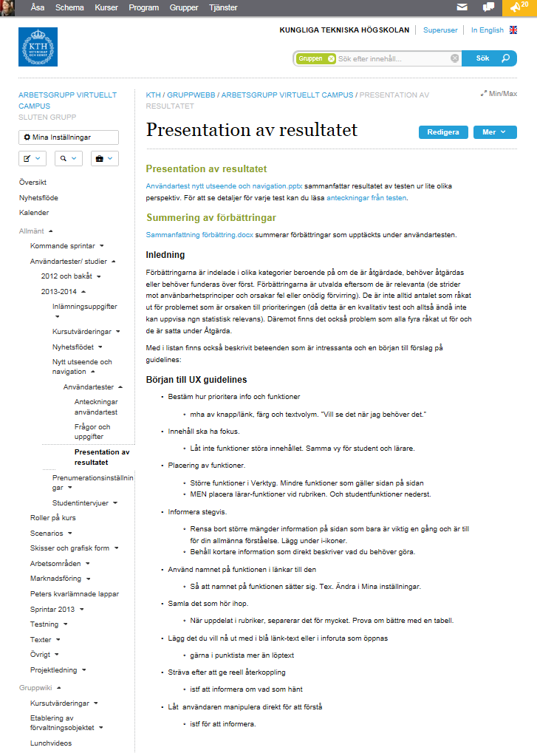
User studies, usability tests
Student/ teacher interviews
Usability test of new functions
  Issue:
    Cost of develop an integrated system
Combined test of smaller improvements with interviews
  Issue:
    No planning for usability tests
    Not prioritize improvements for coming sprints
Scenarios for students and teachers
Design guidelines
Notes:
When it comes to
usability tessing and user studies
We have done
Student/ teacher interviews
Usability test of new functions
Issue:
We can’t make all improvement we found due to
cost of development of an integrated system that shall be exchangeable
Combined test of smaller improvements with interviews
Issue:
No planning for usability tests since small improvements
We not always make another sprint with improvements from usability tests
Ongoing work with scenarios for students and teachers
Ongoing work with design guidelines

Slide 11
Example user studies - scenarios
Today:
Different persons in our organizations captures pieces of knowledge about (part) of our users.
Developers have a fragmented view of our users.
Goal: Know what users do in their daily work/ life at KTH
By: Gather and structure information in a usable form for Business operation and IT
Notes:
I have started a work with scenarios
Today:
Different persons in our organizations have some knowledge about (part) of our users.
You can here someone say:
you know teachers often do, want etc
Or: They say all do things in different ways.
But which different ways? And why?
And when you look into it you can see a pattern that you do thing differently in certain situations
Goal:
Know what users do in the their daily work/ life at KTH.
By:
Gather and structure information in a usable form for Business operation and IT

Slide 12
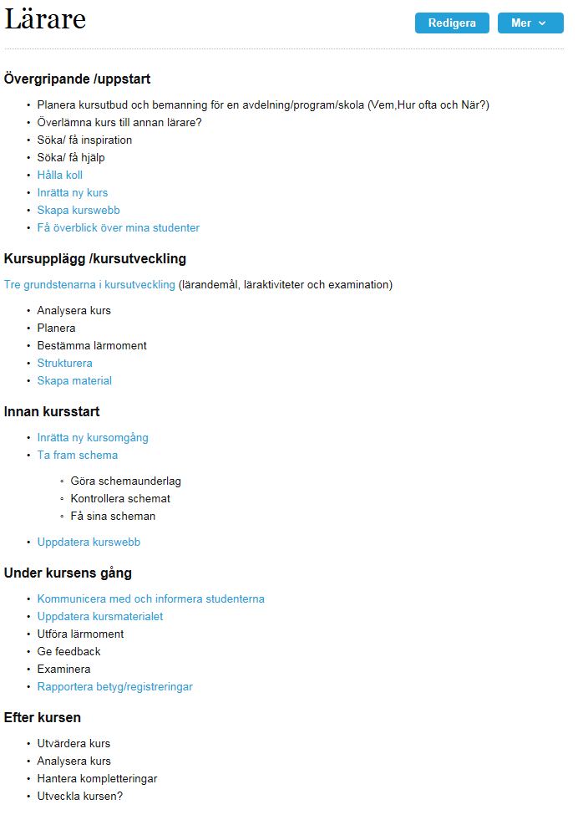
Example scenarios
Role - Teacher
What are their tasks?
When in time?
Are there different ways of doing the same task?
…depending on the user’s situation?
Notes:
Example scenarios
What are their tasks?
When in time?
Are there different ways of doing the same task?
…depending on the user’s situation?
Here we have started to list an overiew of a teachers sceanrios from our knowledge.
Our goal is to from interviews verify existing information and add more

Slide 13
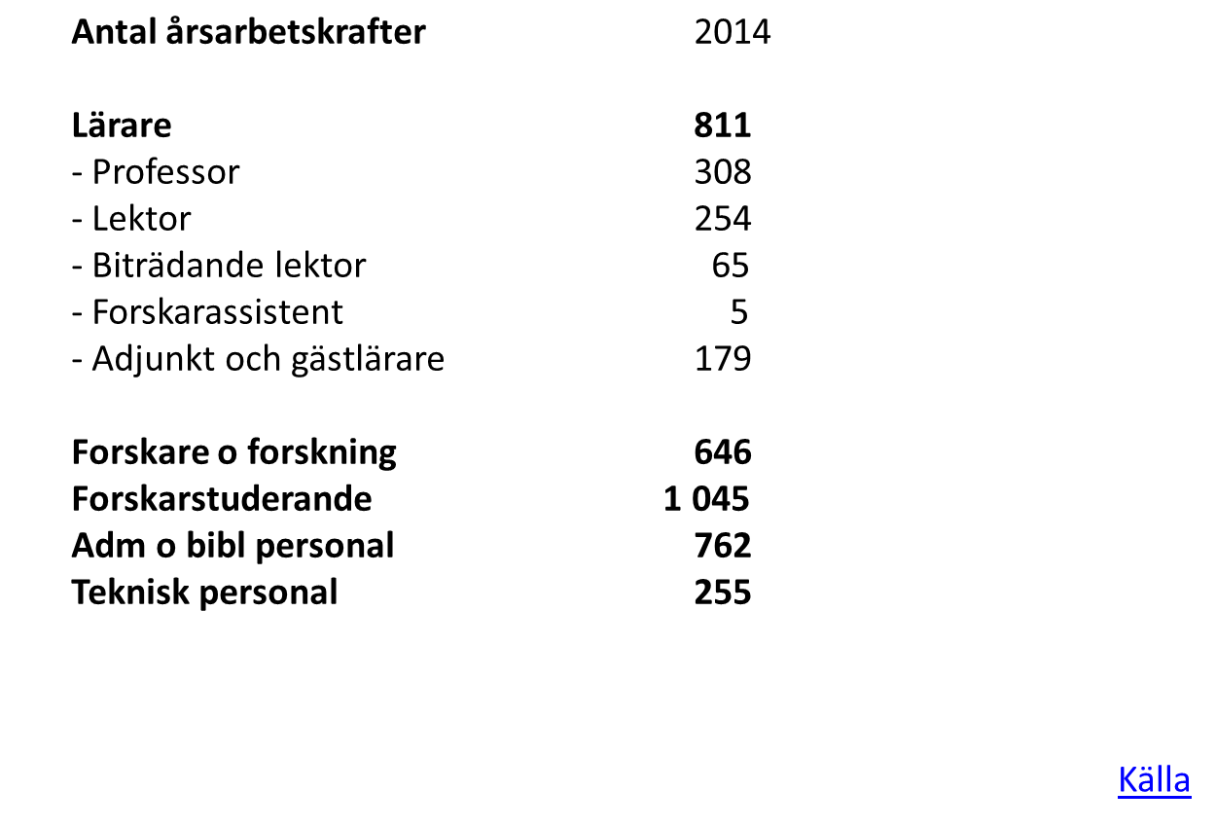
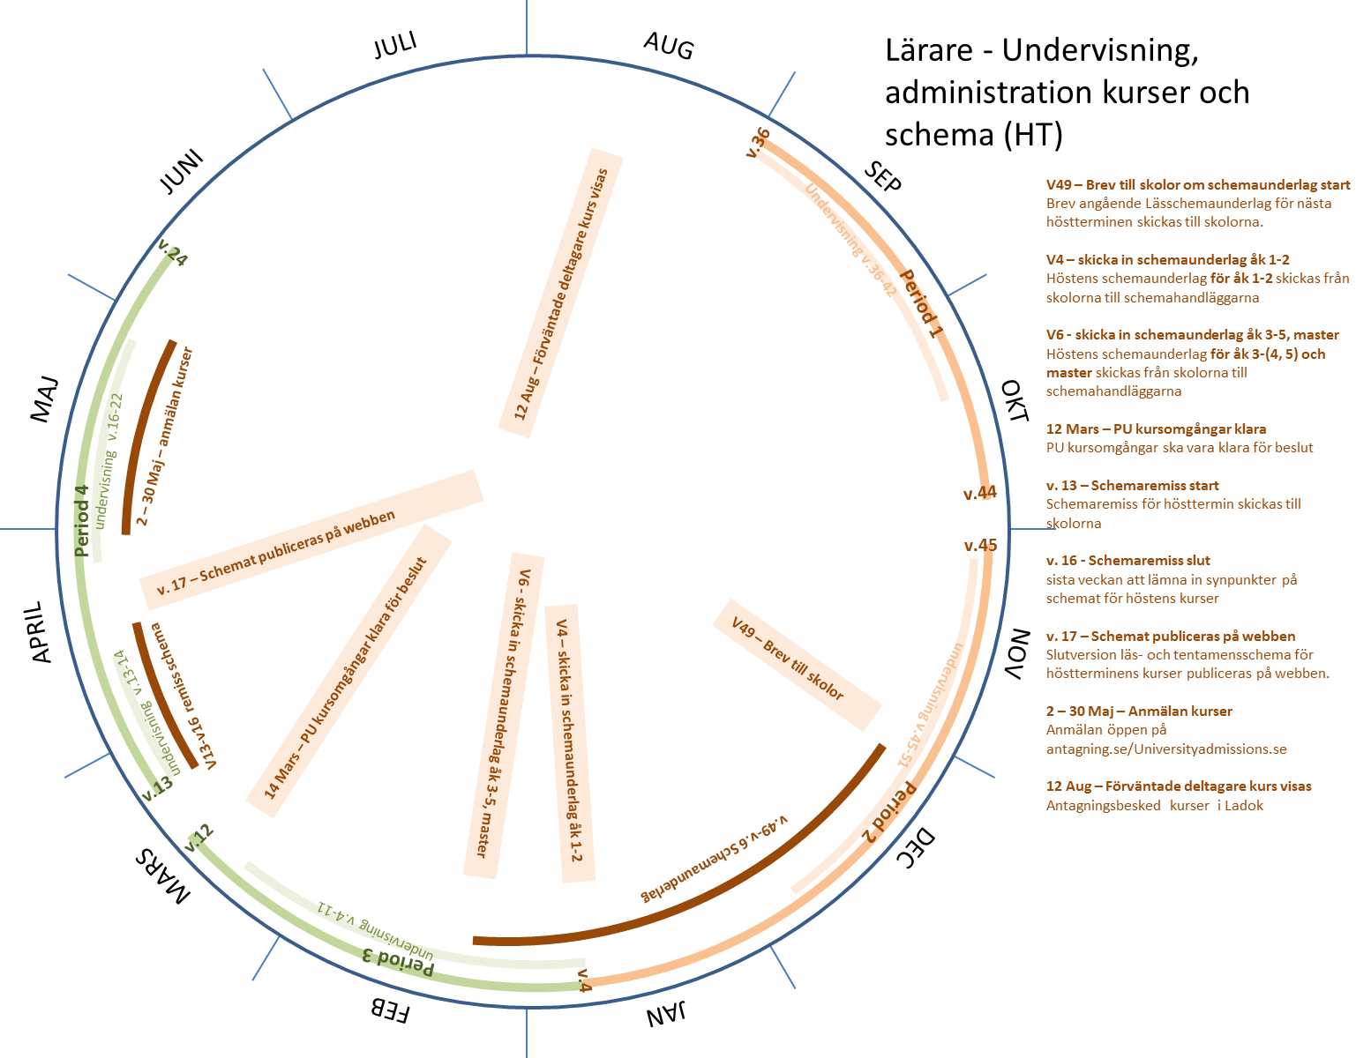
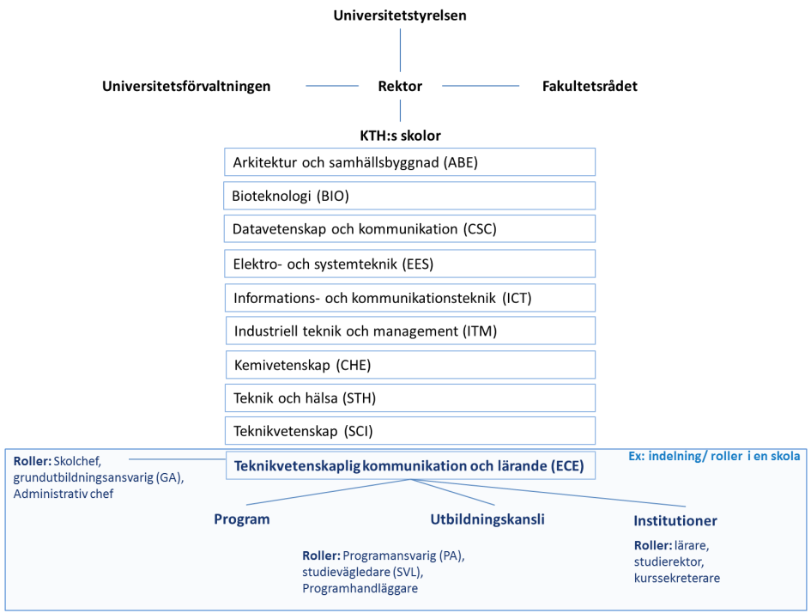
Example scenarios
Staff at KTH
Roles Teachers - teaching, administration courses and schedule (autumn semester)
Who is working where?
Notes:
Some examples how I
Try to visualize for us in the project who are our users:
What are the roles at KTH?
How many in each role??
Who is working where??
And when are, here teacher, doing what?

Slide 14
How are we working?
Notes:
And how are we working?

Slide 15
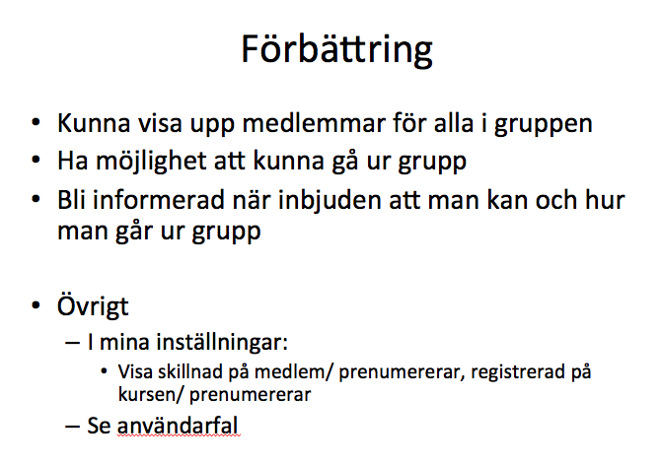
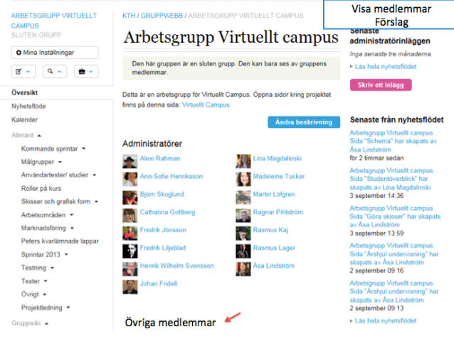
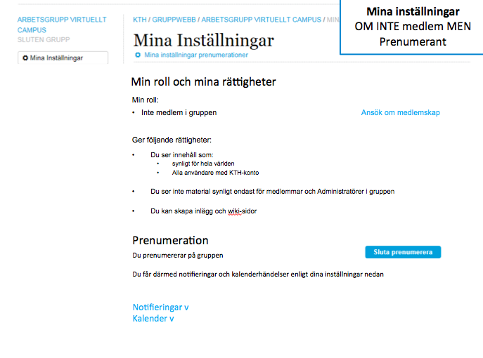
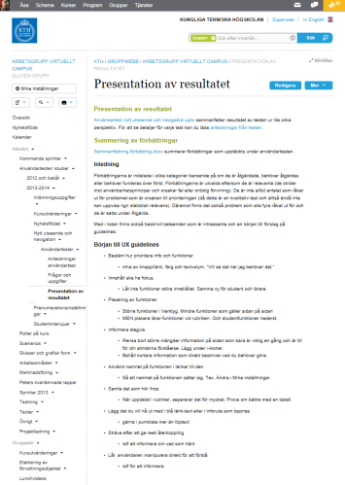
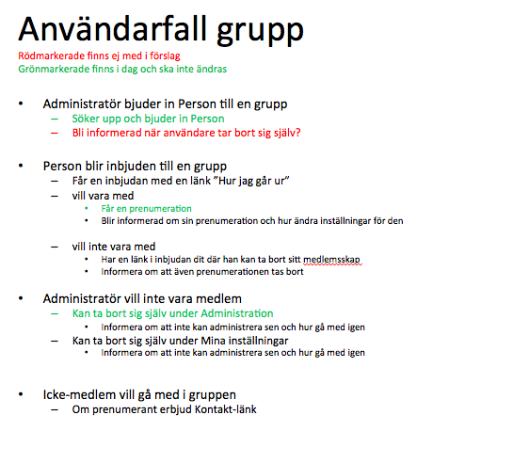
How are we working?
Simple design
Also
Team work - test and change
Make it consistent
See improvement in a context
Guidelines
Scenarios
User test
User study
Guidelines, Scenarios, Personas,
Notes:
When we work with an imrovement
We list what the improvemnt solve
Often in form of an user story
MAKE IT CONSISTENT
Also
To make it consistent we
In the same time work with overall guidelines
SIMPLE DESIGN
I make simple design in ppt
Designer deveop a first version
We sit together and test, change and test gain
SEE IMPROVEMENT IN A CONTEXT
I have recently started to list scenarios in the same context
It makes it easier to see an whole
USER TEST
When we have done user tests it is after we have reach a stat where the user can test in our reference environment
I list improvement which we prioritize and develop a new version
USER STUDY
From interviews and feedback we can update Scenarios, guideline and Personas

Slide 16
Important in UX work - number one
A functional team (✔)
UX design
Develop
A team working together with user experience
  Respect competences…
  …and help out over limitations.
  Listen, share ideas, test and change
  UX a common responsibility
  Attitude - it is ok, not to know!
UX is
  empathy, thinking outside yourself -> practice this in your team
  question what is established, thinking new <- feel safe in your team
Notes:
For me Number one to be able to work with UX
is to be in a
A team working together with user experience
To respect each other’s competences
and at the same time, helping out over limitations. ‘
Listen, share ideas, test and change
UX is a common responsiblity
Attitude: it is ok, not to know!
It can sound obvious but I in other places experience the opposite
Developer is doing their own thing,
ignoring design and without discussing.
They know and decide
Interactiondesigner has work for a long time with a design and handover the final document.
Have not take into consideraton limitations due to the system or other aspects.
Is not really listening to developers suggestions.
For me UX is
about empathy, thinking outside yourself.
It is a good way to practice this in the team work
question what is established, thinking new.
To do this, you have to feel safe in your team

Slide 17
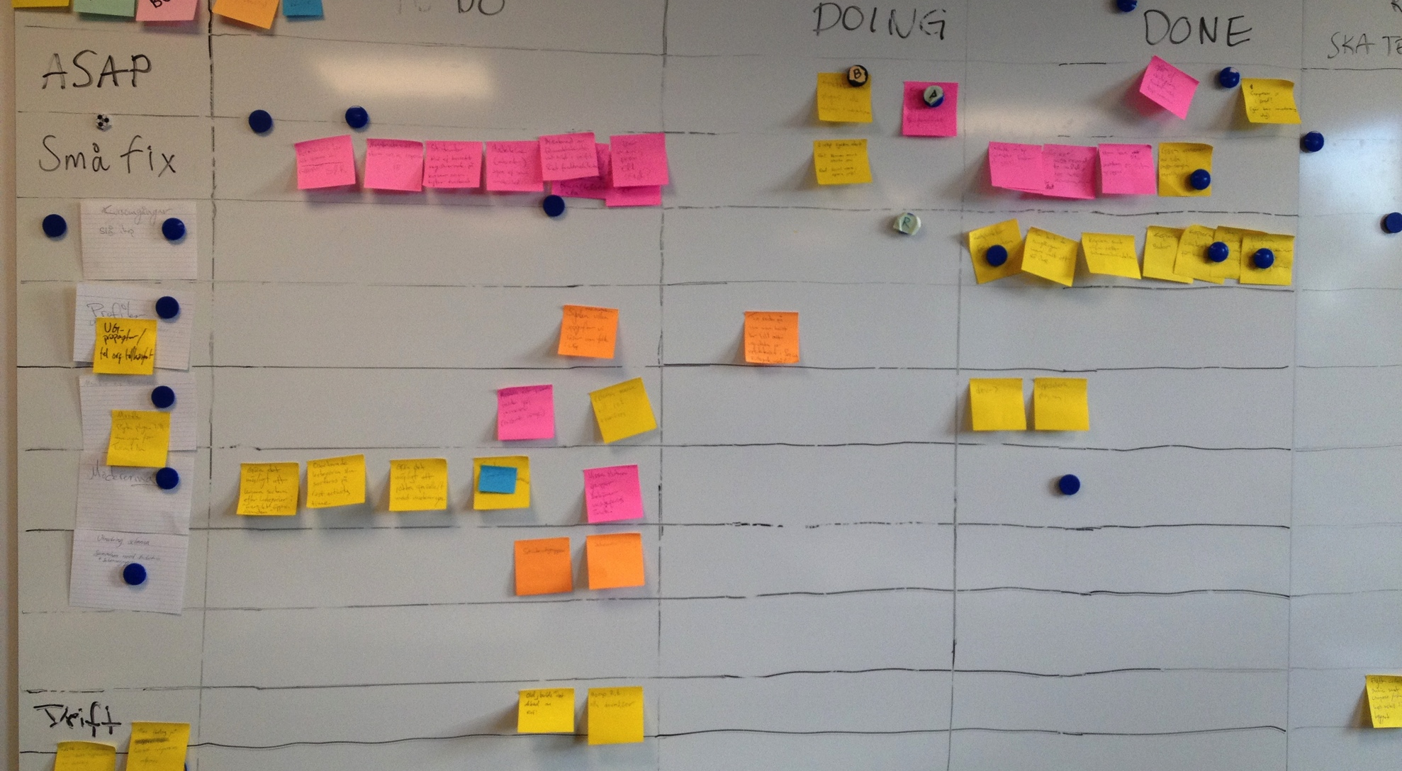
Important in UX work - number two
Planning (need to improve)
A1
User story 1
Develop
Usability test
A1
User story 2
Develop
  A1
User story 3
Develop
  A1
Common
Interaction
design
Develop
Improvements
Usability test
A2
User story 1
Interaction
design
Develop
A3
User
study
User
study
Backlog
A2 A3
User study
User story 1
User test
User story 3
User study
User story 2
Guidelines, Scenarios, Personas
Goals, Roadmap, UX strategy
Notes:
For me, maybe because this not working in the best way right now, number two important in UX work is planning
First, this is how we work to day.
The task added is mainly focus on developing.
UX activities, like interaction design happens anyway.
Usability test and userstudy is harder to find time for
How could it be?
1. As a base you need:
goals, a roadmap,
UX guidelines, personas, scenarios
2. You then need:
A backlog divided into bigger focus areas
get away from smaller scattered improvements
bundle improvements in a bigger areas
as for e.g. Subscription,
In a focus area you plan for some type of user study ande user tests
Here you work in parallell with 3 different focus areas
3. You can then spread tasks in time so you can be ahead with user studys for future user areas and usability test the latest

Slide 18
How are we working?
Need to improve in the new managmentobjekt
  Clear goal, roadmap, backlog
  To prioritize focus areas and get away from smaller fragmented improvements
A planning including user studies, design and usability
To make it happen and continuously to get the best result
Notes:
What we need to improve
Virtuellt Campus project will become something called management object. Something to maintain.
So work is ongoing to set
Clear goal, roadmap, backlog
Which will make it easier to prioritize focus areas and get away from smaller fragmented improvements
We also need to improve the planning including user studies, design and usability
To make it happen and to get the best result,
Since you can’t rely on random, ad hoc UX activities in case of time and resources.

Slide 19
How are we working?
We also need a solution for
UX resources - one person can’t have skills or time to practice
  Project planning, Requirement handling, Methods, Processes, Concept design, Interaction design, Graphical design, User research, Technic, Analyzing, Statistics, Communicting, Information architecture, Marketing
User studies
      how can we continuously collect user’s needs?
      in an effective way?
      what is good enough?
      how can we present it in a usable way for business operation and ITA?
How do we continuously be updated about other solutions, methods, processes
Notes:
We also need a solution for
UX resources - One person can’t have skills or time to practice
Project managing
Requirement handling
Methods,
Processes
Concept,
Interaction design
User research skills
Technical
Analythic
Statistics
---
It is always not the same person that is best on analyzing data and communicate, plan and sell in UX.
User studies
how can we continuously collect user’s needs
in an effective way?
what is good enough?
how can we present it in a usable way for business operation and ITA?
Personas and or scenarios?
How do we continuously be updated about other solutions, methods, processes .. …

Slide 20
Discuss
How can we coorporate?
Notes:
So how can we coorporate?

Slide 21
Suggestions so far
I am here to day
ITA have give proposals for MID students in course DH2408 Evaluation Methods in Human Computer Interaction
MID can give a Seminars for ITA
Notes:
The suggestions so far have been
I am here to day
ITA will give proposals for usability evolutions for MID students (DH2408 Evaluation Methods in Human Computer Interaction)
MID Seminar for ITA
One suggestion is: ”Att beställa användbara IT-system”
to Inform and educate ”The Business operation”
My suggestion is to also add a Complementary workshop that is more practical and adress:

Slide 22
Discuss
What can MID gain from a cooperation with ITA?
How can ITA use your knowledge best?
Notes:
So let’s start a discussion
What do you think
MID can gain from a cooperation with ITA?
How can ITA use your knowledge best?
----- Mötesanteckningar (2014-09-29 10.03) -----
funka - stefan

Slide 23
UX arbete fortsättning

Slide 24
Vill uppnå
Prioritera användarnytta först, sen lösning
Planering där user study and test finns med
Finns tid för ID och förberedelse för test och studie
Ett definierat sätt och plats hur vi samlar in
  Hur man gör i dag
  Problem
  Hur man vill göra
Och använder det man samlat in i ID

Slide 25
Samla in info om Användare
Kommande sprintar
På tavlan
På tur
Besluta
F2 User study
Problem i dag
Hur vill man göra?
Planering
Problem i dag
Hur vill man göra?
Feedback
Hur gör man i dag?
Focusarea/ Användarområde
Problemen i dag?
Titta vidare på
.
.
.
Inte lösa (nu)
X
Hur vill man göra?
Vad behöver vi ta reda på?
Priade User stories
Hur gör man i dag?
Scenarios/ Användarfall
Hur gör man i dag?
När?
Vad är anledningen?
Gör man olika i olika situationer?

Slide 26
Planera
Kommande sprintar
På tavlan
På tur
Besluta
Lösning ok
F2: User study
F1: User story 1
Användarnytta
F1: ID User story 2
F1: ID User story 3
F3: Förbereda
user study
F3: Förbereda
user test
F1. User story 4
F1: User story 5
Nästa focus område F4
Planering
Beslut -> På Tur
Prioritera utifrån användarnytta och beroenden!
Nytt focusområde?
  planera in user study, test
Inom focusområdet:
  Nästa user storie?
På tur -> På tavlan
User story - Interaktionsdesign färdig
  Lösning/ ID ok?
    Flytta till På tavlan.
Förberett User test, User study
  Förberedelser ok?
    Flytta till På tavlan
  -> Beslut
Fyll på
Focusarea/ Användarområde
Scenarios/ Användarfall

Slide 27
Använda användardata
Kommande sprintar
På tavlan
På tur
Besluta
F2: User study
F1: User story 1
F1: ID User story 2
F1: ID User story 3
F3: Förbereda
user study
F3: Förbereda
user test
F1. User story 4
F1: User story 5
Nästa focus område F4
Planering
Vad behöver vi veta mer
Hur vill man göra?
Hur vill man göra?
Hur gör man i dag?
Focusarea/ Användarområde
Scenarios/ Användarfall

Slide 28
Backlog
Backlog uppdelad i två delar
  Övre delen det som är prioriterat och en del designat
  Undre delen uppdelat per focusområde
    Samlat inte så fragmenterat
    Samlar, det vi vet och inte vet
Vi har nu saker i Jira, Google docs och här?

